Slide 1
Connecting with LXI
LAN eXtentions for Instrumentation
LXI Consortium Presentation
May 14, 2017
Notes:
Welcome to this series of presentations on LXI. If you are new to LXI, this is the presentation for you

Slide 2

Connecting with LXI
LAN eXtentions for Instrumentation
LXI Consortium Presentation
May 14, 2017
Notes:
This presentation covers key aspects of connecting to LXI Instruments as found in the LXI Getting Started Guide

Slide 3
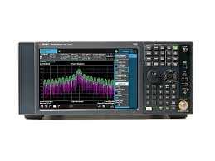
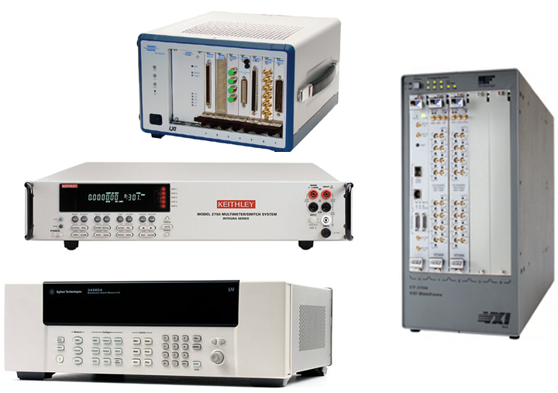
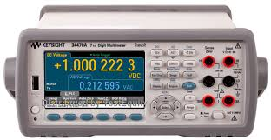
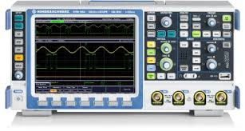
LXI Products and Productivity
Over 3600 Instruments are LXI Conformant
All LXI Devices connect the same over LAN
All LXI Devices come with an IVI Driver
Most LXI Devices have Web Monitoring/Control
LAN Connectivity can be easy and inexpensive
…but why are these facts important?
Notes:
Established in 2004…over 55 of the top T&M companies sponsored and developed this technology, and there are more than 3600 products in over 50 different product families. LXI (LAN eXtensions for Instrumentation) is the current and future standard for Test and Measurement Systems.
Prior to this standard there were LAN-based instruments, but there were as many different ways of configuring these devices as there were products. With the LXI Standard, all devices behave the same when connecting to LAN, they all come with easy to use IVI Drivers, example programming, and most have added Web Pages for monitoring and controlling functionality.
LAN Connectivity is common, fast, inexpensive, and reliable…all features you want in a test system.

Slide 4
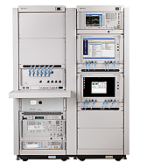

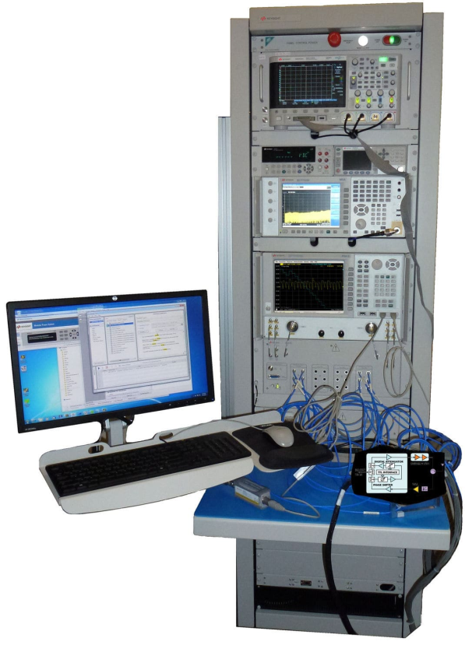
The Situation
You want to work here…
14000 km
60 meters
…but your Test Systems are way over there
…and in a noisy environment.
Notes:
For a test system engineer, it is usually inconvenient and uncomfortable to work next to the test system. You want the comfort of a quiet office environment to develop your test programs. Necessity is also a consideration, since the test system you are supporting may be in another country. LXI provides capability not found in other interfaces…as we shall see.

Slide 5
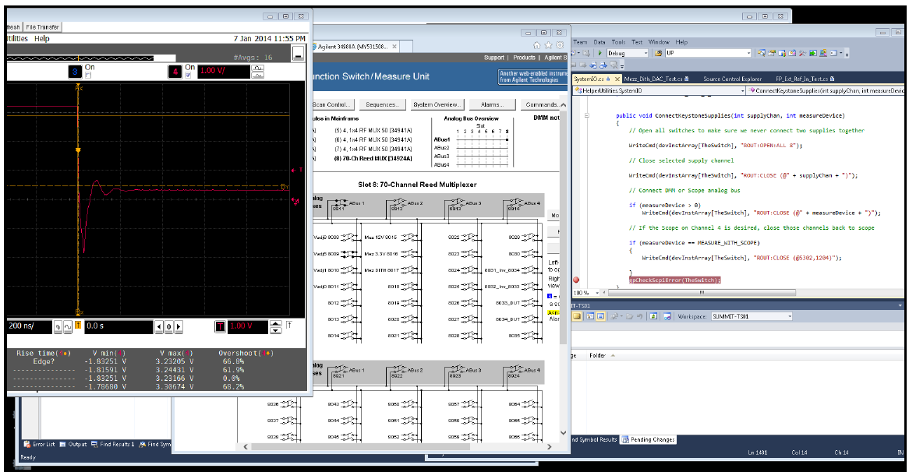
How could you achieve your goal?
You can Remote Login to the Test System PC
LXI Devices in test system share a private LAN with PC
IVI Drivers provide quick access to LXI Device functionality
You can monitor/debug your code via Web Pages
Test
Program
Web Page
Scope
Web Page
Switching
…but, how and where do I start?
Notes:
It is a common solution to Remote Login to your test system…nothing special about that. But, with LXI Devices, that remote connection then provides Web Page access to the various measurement and control devices. For example, a test is failing, so you step through the test program looking at the result on the Scope Web page. Hmmm…not right…so, you check the switch path using the Switch Web Page. Ah…wrong combination of switches…problem solved! And, you did it from the comfort of your desk.

Slide 6
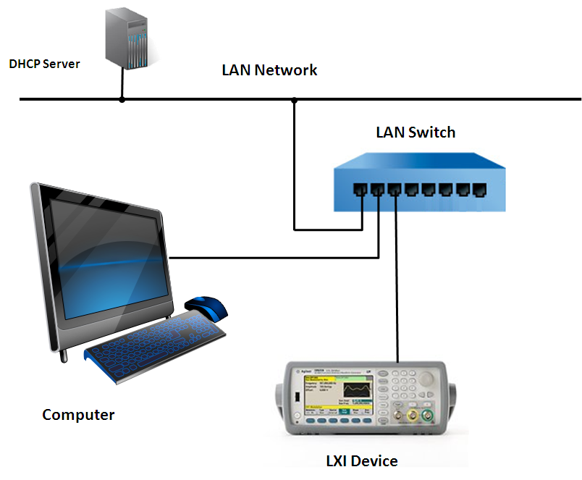
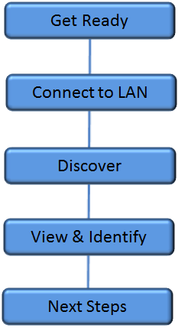
Let’s just focus on one LXI Device
…we’ll talk about a full Test System in a later video
Notes:
In the presentation Building LXI-based Test Systems, you will learn about connecting multiple LXI devices together. For now, just learning how one works will solidify your understanding of how they all behave when connecting to LAN. We’ll follow these key steps in the presentation to connect and use an LXI Device.
The image illustrates a typical business network. Let’s explore this further…

Slide 7
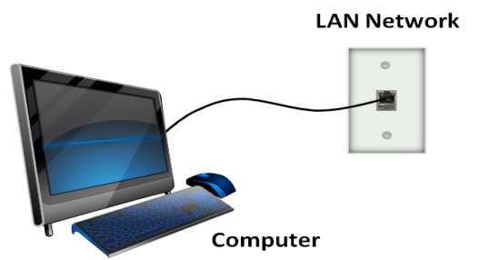
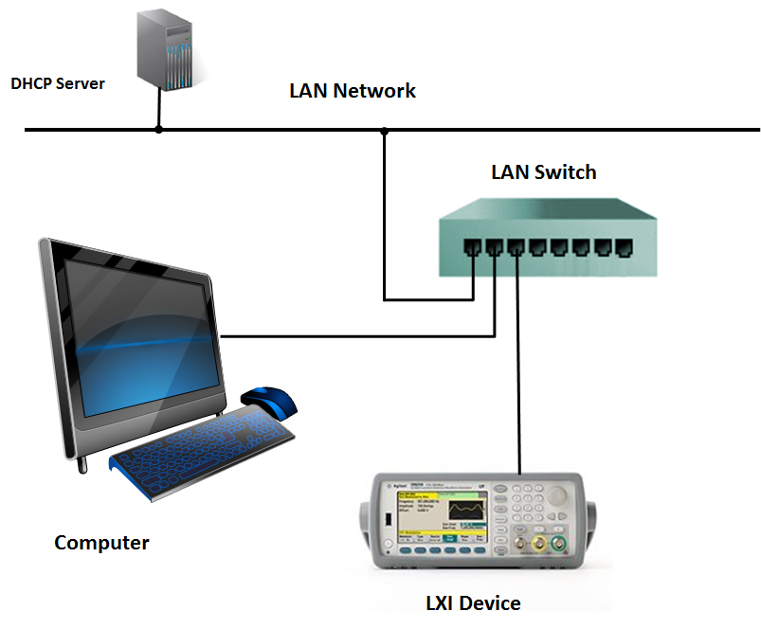
Get Ready – What do you need?
What you have
Computer
LAN Connection
What you need
Two more LAN cables
LAN Switch or Router
LXI Device
Notes:
For most employees, you were equipped with a cubicle that has a single LAN port connected to your computer.
To connect your LXI device to your computer, you need the listed items. For this example, you have essentially added LAN ports to your cubicle by adding a LAN Switch. Your computer is still connected to your companies LAN, but now your LXI Device is connected too.

Slide 8
Connect – Is it that simple?
What happens?
Computer and LXI Device ask the DHCP Server for an IP address
That’s it!
What can go wrong?
LXI Device may be set to static IP address
Now what…?
…LXI Reset to the rescue
Notes:
Office computers – especially laptops – are almost always configured for DHCP operation such that when you connect to the company LAN, there is a DHCP Server that provides your computer with an IP address…no matter where you plug in.
LXI Devices operate much like these computers…however…if something goes wrong and you can’t connect, an LXI Device is much more friendly to resolve the situation than your computer.
Where did you get that LXI Device? Like your mother said when you were little – “Don’t put that in your mouth…you don’t know where it’s been”. Wise words and appropriate for LAN. LXI Devices new from the vendor will be configured for DHCP operation, but that LXI Device you borrowed from Bob may have been configured for his specific environment and may not work properly in yours. LXI Reset to the rescue…

Slide 9
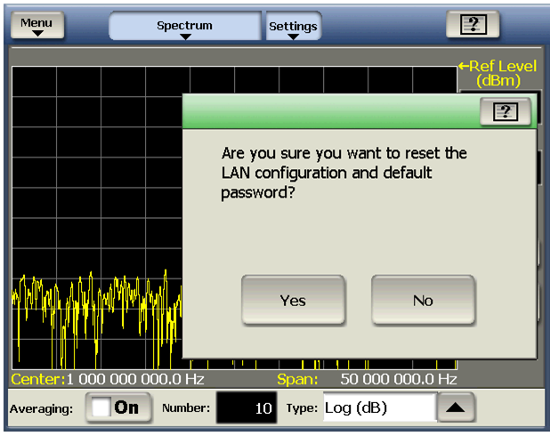
Connect – Restoring DHCP Configuration
What does LXI Reset Do?
Defaults to looking for DHCP Server
Resets password
Where is LXI Reset?
A recessed button
A soft button under System or Utility Menu
Notes:
LXI Reset is a way to restore the LXI device to its default LAN configuration – DHCP, and it also clears any password Bob may have used to keep his LXI Device from being accessed. Since you have the LXI Device in front of you, you have the ability to perform an LXI Reset.
The LXI Reset will either be down a couple levels in the front panel menu, or it will be a recessed button on the front or rear of the LXI Device.
LXI Reset is protected from accidental access either by a Dialog Box asking if you really want to reset…or by a recessed button.
Once pressed the LXI device will now behave properly and connect just like your computer.

Slide 10
Connect – Success!
Indicator shows LAN status
… but, I need its IP address to talk to it
Notes:
If you are connected properly, there will be some sort of indication on the front panel of the LXI device – either a Green LED or icon or other indicator on the front panel display. A Red LED or LAN Fault message indicates its time for an LXI Reset to restore LAN connectivity.
Do you know your computer’s IP address?...its hostname? There are ways to find out using your operating system. You need that information if you want to connect to your computer from another computer via Remote Login. Without that IP address or hostname, you can’t program the LXI device or bring up its Web Page.

Slide 11
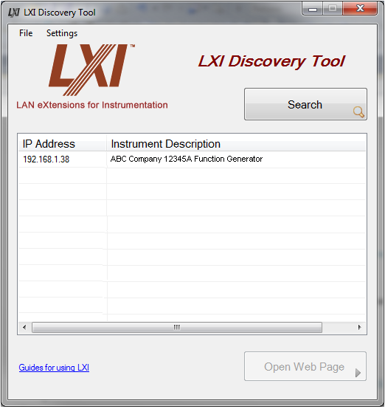
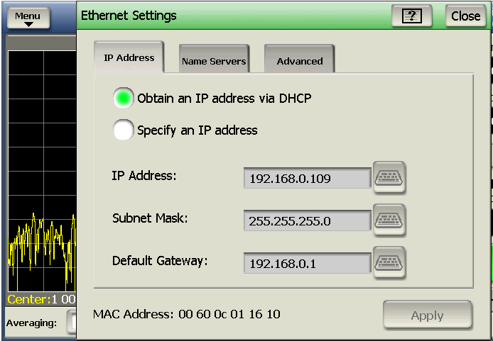
Discover – How to find the device
…you need an IP Address or Hostname to bring up Web Page or program device
Discovery Tools
LXI Discovery Tool
Keysight IO Connect
NI Max
Notes:
If your LXI Device has a front panel display, you can usually find the IP address or hostname under the Utility or System menu. But, if you are really planning to program that LXI Device, the vendor will have instructed you to install the VISA IO Libraries – Keysight, National Instruments, Tektronix…and there are several others. These installations provide an LXI Device discovery tool.
The LXI Consortium also provides a light-weight LXI Discovery Tool. We’ll talk more about the VISA IO Library tools in Building LXI-based Test Systems. For now, let’s use the LXI Discovery Tool to find the LXI Device and bring up its Web Page

Slide 12
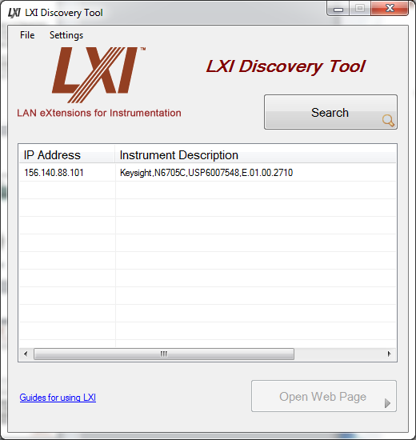
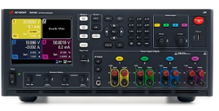
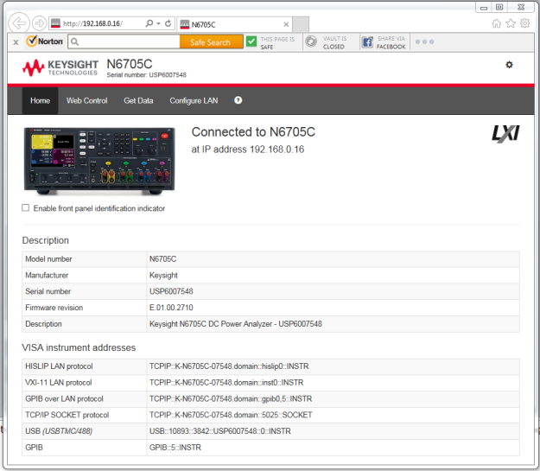
Quick Demo
Notes:
This demo illustrates using the LXI Discovery Tool to find an LXI device. The demo shows finding the LXI device, bringing up its Welcome Page, and perusing some of the typical pages on an instrument.

Slide 13

Next Steps – Guides/Videos for Using LXI
Connecting with LXI
Building LXI-Based Test Systems
Introducing LXI To Your Network Administrator
Maximizing Performance of LXI-Based Test System
Test Systems Using LXI
LXI Networking Basics
http://www.lxistandard.org/About/Guides-for-using-LXI.aspx
Notes:
You have learned how to connect to an LXI Device. There are additional videos on the above topics, and there are papers available with much greater detail found at the LXI Consortium Website. Refer to this link for access to both videos and documentation.
Thank you for your time.

